Slide 1
Big Data Integration
Web Services
Lecture 4
College of Computing Technology (CCT), Dublin, Ireland.
Lecturer: Dr. Muhammad M Iqbal
Ph.D (DCU), M.Phil (GCU)

Slide 2
Web Services
Part 1
Web Services
Part 2
Create a Web Service (locally)
Part 3
Consume a Web Service (locally)
Part 4
Consume a Web Service (Present on Moodle)
Notes:
2

Slide 3
Introduction
Web service
  A software component stored on one computer that can be accessed via method calls by an application (or other software component) on another computer over a network
Web services communicate using such technologies as XML/ JSON and HTTP
Simple Object Access Protocol (SOAP)
  An XML-based protocol that allows web services and clients to communicate in a platform-independent manner

Slide 4
Introduction
Companies
  Amazon, Google, eBay, PayPal and many others make their server-side applications available to their partners via web services.
By using web services, companies can spend less time developing new applications and can create new applications in an innovative way in small amount of time.
Netbeans 6.5 - 9 and Java EE enable programmers to “publish (deploy)” and/or “consume (client request)” web services

Slide 5
Java Web Services Basics
Remote machine or server
  The computer on which a web service resides
A client application that accesses a web service sends a method call over a network to the remote machine, which processes the call and returns a response over the network to the application
In Java, a web service is implemented as a class that resides on a server
Publishing (deploying) a web service
  Making a web service available to receive client requests
Consuming a web service
  Using a web service from a client application

Slide 6
Java Web Services Basics
An application that consumes a web service (client) consists of two parts
  An object of a proxy class for interacting with the web service
  A client application that consumes the web service by invoking methods on the proxy object
  The proxy object handles the details of communicating with the web service on the client’s behalf
JAX-WS 2.0
  Requests to and responses from web services are typically transmitted via SOAP
  Any client capable of generating and processing SOAP messages can interact with a web service, regardless of the language in which the web service is written

Slide 7
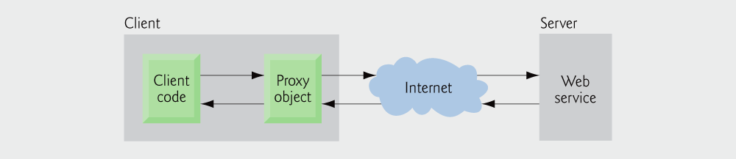
Interaction between a web service client and a web service.

Slide 8
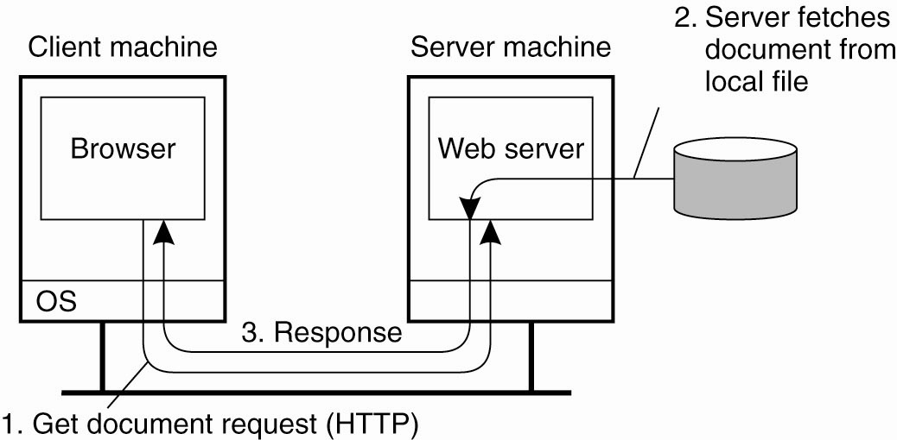
Traditional Web-Based Systems
The overall organization of a traditional Web site.

Slide 9
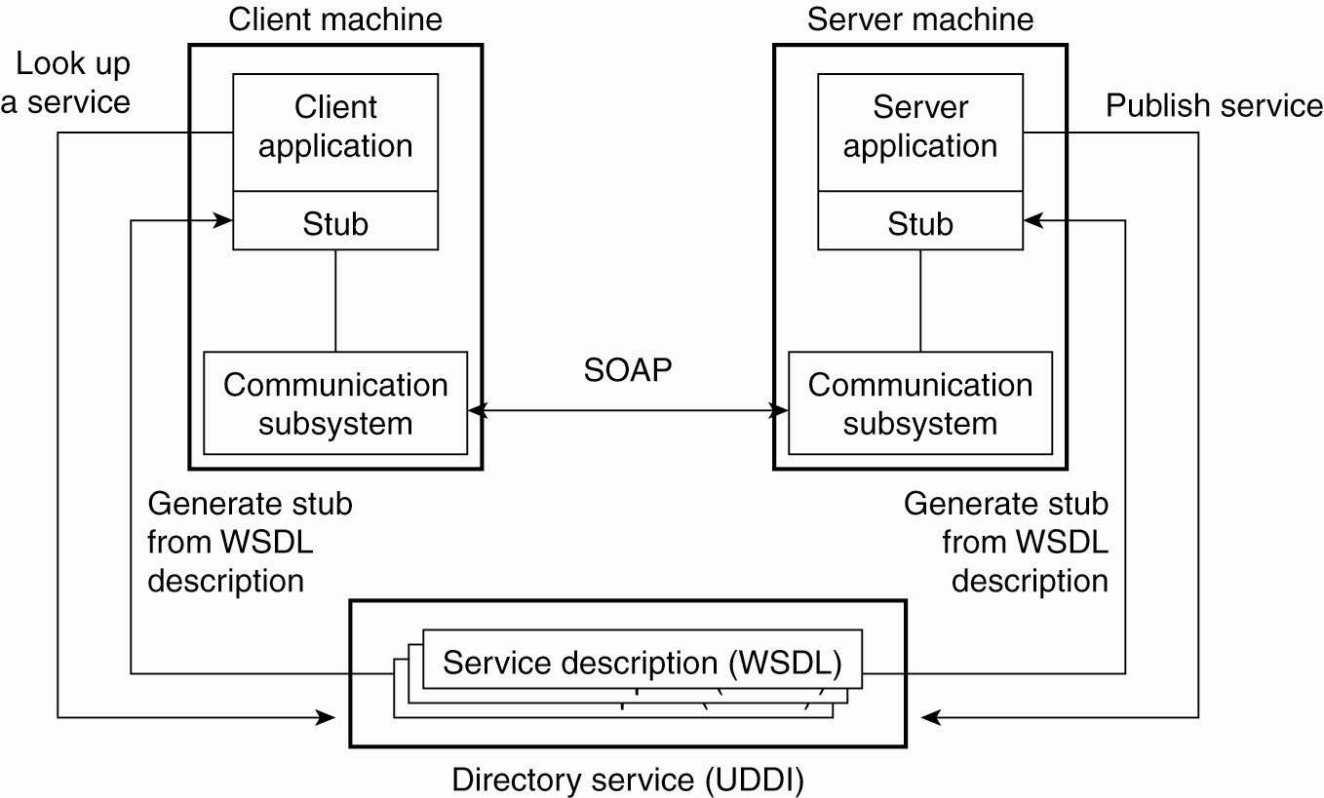
Web Services Fundamentals

Slide 10
Creating, Publishing, Testing and Describing a Web Service
Example: HugeInteger web service
  Provide methods that take two “huge integers” (represented as Strings)
  Can determine their sum, their difference, which is larger, which is smaller or whether the two numbers are equal

Slide 11
Creating a Web Application Project and Adding a Web Service Class in NetBeans
In Netbeans, you focus on the logic of the web service and let the IDE handle the web service’s infrastructure
To create a web service in NetBeans
  Create a project of type Web Application
  The IDE generates additional files that support the web application

Slide 12
Defining the HugeInteger Web Service in Netbeans
Each new web service class created with the JAX-WS APIs is a POJO (plain old Java object)
  You do not need to extend a class or implement an interface to create a Web service
When you compile a class that uses these JAX-WS 2.0 annotations, the compiler creates the compiled code framework that allows the web service to wait for and respond to client requests

Slide 13
Defining the HugeInteger Web Service in Netbeans
@WebService annotation
  Indicates that a class represents a web service
  Optional element name specifies the name of the proxy class that will be generated for the client
  Optional element serviceName specifies the name of the class that the client uses to obtain a proxy object.

Slide 14
Netbeans places the @WebService annotation at the beginning of each new web service class you create
You can add the optional name and serviceName elements in the annotation’s parentheses
Methods that are tagged with the @WebMethod annotation can be called remotely
Methods that are not tagged with @WebMethod are not accessible to clients that consume the web service

Slide 15
@WebMethod annotation
  Optional operationName element to specify the method name that is exposed to the web service’s client
Parameters of web methods are annotated with the @WebParam annotation
  Optional element name indicates the parameter name that is exposed to the web service’s clients

Slide 16
Part 1
Create a Web Service (locally)
Notes:
16

Slide 17
Create a Web Service
To generate a web service client in the IDE from a web service or WSDL file you need to modify the IDE configuration.
Go to /home/hduser/netbeans-8.2/etc/netbeans.conf
Find the line: netbeans_default_options
If -J-Djavax.xml.accessExternalSchema=all is not between the quotes then paste it in.
Save the file and exit.
Notes:
17

Slide 18
Create a Web Service
If you are deploying to the GlassFish Server you need to modify the configuration file of the GlassFish Server (domain.xml)
/home/hduser/glassfish-4.1.1/glassfish/domains/domain1/config/domain.xml
Find : <java-config
Check the jvm-options for the following configuration
<jvm-options>-Djavax.xml.accessExternalSchema=all</jvm-options>
It should be there by default, if not paste it in, save file and exit
You can now start Netbeans IDE
Notes:
18

Slide 19
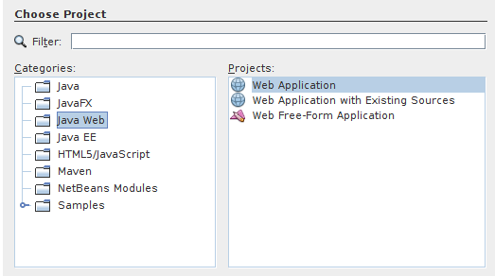
Create a Web Service
Choose File > New Project
Select Web Application from the Java Web category
Click Next
Notes:
19

Slide 20
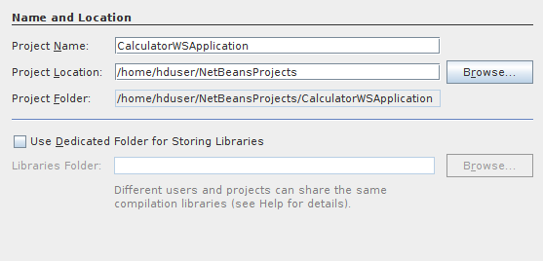
Create a Web Service
Change Project Name: to CalculatorWSApplication
Click Next
Notes:
20

Slide 21
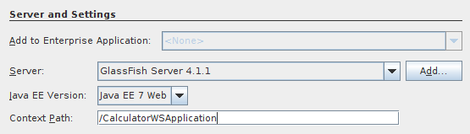
Create a Web Service
Set the server to GlassFish 4.1.1
Set Java EE Version: Java EE 7 Web
Set Context path: /CalculatorWSApplication
Click Finish
Notes:
21

Slide 22
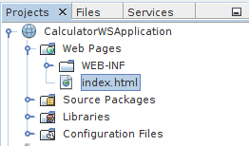
Create a Web Service
You should now have a project created in the Projects view on the left hand side.
The main view will display index.html
Notes:
22

Slide 23
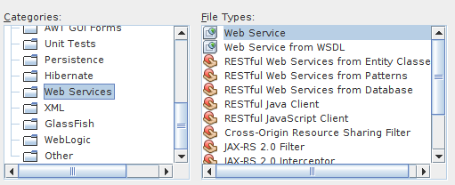
Creating a WS from a Java Class
Right-click the CalculatorWSApplication node and choose New > Web Service.
If the option is not there choose Other > Web Services > Web Service
Click Next
Notes:
23

Slide 24
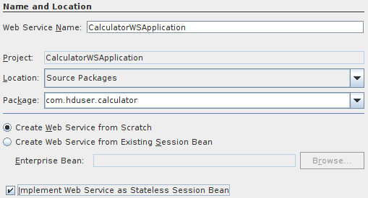
Creating a WS from a Java Class
Name the web service CalculatorWS and type com.hduser.calculator in Package. Leave Create Web Service from Scratch selected.
Select Implement Web Service as a Stateless Session Bean.
Click Finish. The Projects window displays the structure of the new web service and the source code is shown in the editor area.
Notes:
24

Slide 25
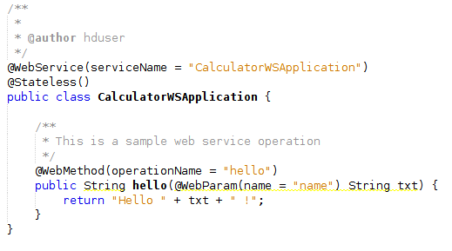
Creating a WS from a Java Class
A default hello web service is created by Netbeans
Notes:
25

Slide 26
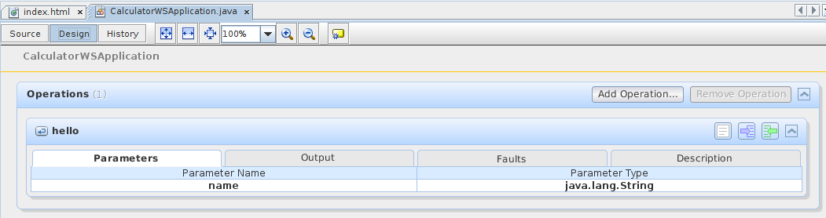
Adding an Operation to the WS
Change to the Design view in the editor.
Click the Add operation button.
Notes:
26

Slide 27
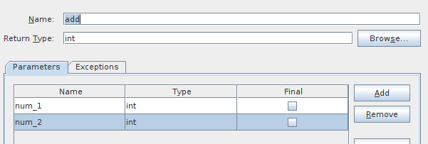
Adding an Operation to the WS
In the upper part of the Add Operation dialog box, type add in Name and type int in the Return Type drop-down list.
In the lower part of the Add Operation dialog box, click Add and create a parameter of type int named num_1.
Click Add again and create a parameter of type int called num_2.
Notes:
27

Slide 28
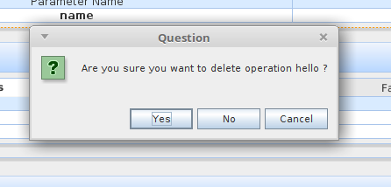
Adding an Operation to the WS
Click OK at the bottom of the panel to add the operation.
Remove the default hello operation.
Right click on hello operation and choose: Remove Operation
Click Yes
Notes:
28

Slide 29
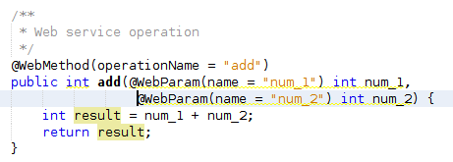
Adding an Operation to the WS
Click on the source view to go back to view the code in the editor.
You will see the default hello code is gone and the new add method is now there instead.
Alter the code to now look like this.
Notes:
29

Slide 30
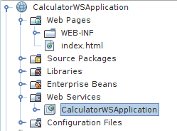
Adding an Operation to the WS
Well done, you have just created your first Web Service.
To test the Web service drop down the Web Services directory and right click on CalculatorWSApplication.
Choose Test Web service.
Notes:
30

Slide 31
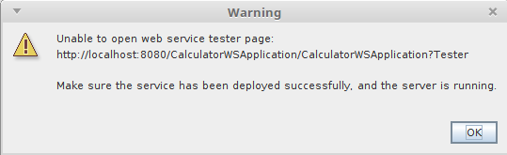
Adding an Operation to the WS
Netbeans throws an error.
It is letting us know that we have not deployed our Web Service.
Right click on the main Project node and select deploy
Notes:
31

Slide 32
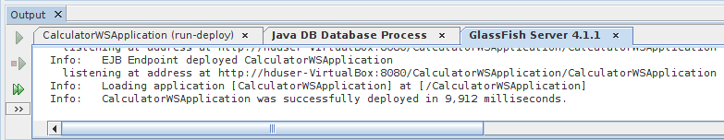
Testing the WS
Deploying the Web Service will automatically start the GlassFish server.
Allow the server to start, this will take a little while.
You can check the progress by clicking on the GlassFish tab at the bottom of the IDE.
Notes:
32

Slide 33
Testing the WS
When you see
CalculatorWSApplication was successfully deployed in 9,912 milliseconds.
Now you can right click on the Web Service as before and choose Test Web Service.
The browser will open and you can now test the Web service and view the WSDL file.
Type 5 and 5 into the input fields and check that you get the response.
Notes:
33

Slide 34
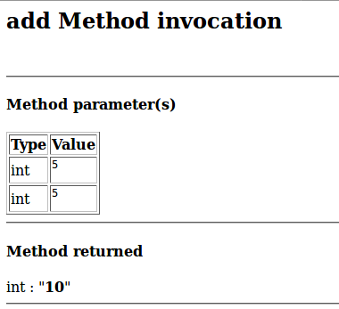
Testing the WS
View in browser
You can also view the Soap Request and Response
Notes:
34

Slide 35
Part 2
Consuming the Web Service
Notes:
35

Slide 36
Consuming the Web Service
Now that we have a web service we need a client to consume it.
Choose File > New Project
Select Web Application from the Java Web category
Name the project CalculatorWSJSPClient
See the next slide for screen shot
Notes:
36

Slide 37
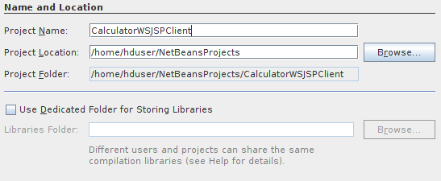
Consuming the Web Service
Once you have entered the project name click Next
Notes:
37

Slide 38
Consuming the Web Service
Leave the server and java version as before and click Finish.
Expand the Web Pages node under the project node and delete index.html.
Right-click the Web Pages node and choose New > JSP in the popup menu.
If JSP is not available in the popup menu, choose New > Other and select JSP in the Web category of the New File wizard.
Type index for the name of the JSP file in the New File wizard. Click Finish.
Notes:
38

Slide 39
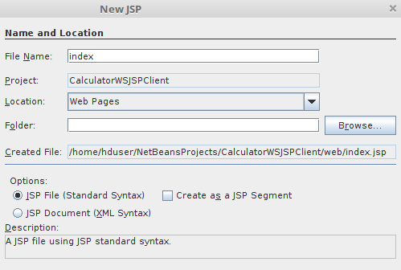
Consuming the Web Service
Click Finish to create the JSP (Java Server Page)
Notes:
39

Slide 40
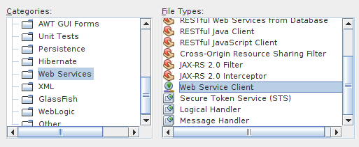
Consuming the Web Service
Right-click the CalculatorWSJSPClient node and choose New > Web Service Client.
If the option is not there choose Other > Web Services > Web Service Client
Notes:
40

Slide 41
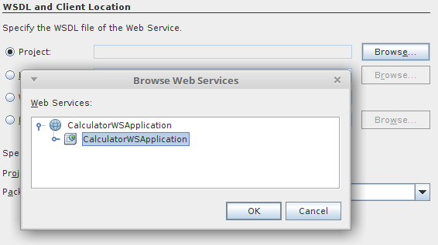
Consuming the Web Service
Select Project as the WSDL source. Click Browse. Browse to the CalculatorWS web service in the CalculatorWSApplication project. When you have selected the web service, click OK.
Notes:
41

Slide 42
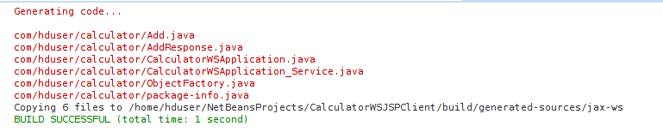
Consuming the Web Service
Do not select a package name. Leave this field empty.
Leave the other settings at default and click Finish.
The WSDL gets parsed and generates the .java
Notes:
42

Slide 43
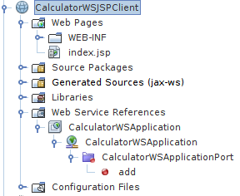
Consuming the Web Service
The Web Service References directory now contains the add method we created in our web service.
Notes:
43

Slide 44
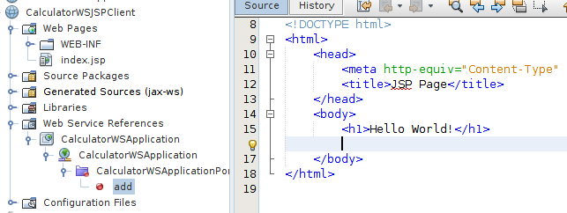
Consuming the Web Service
Drag and drop the add method just below the H1 tags in index.jsp
Notes:
44

Slide 45
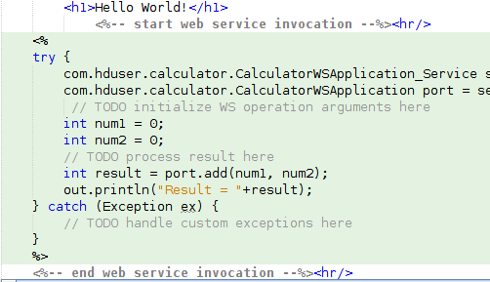
Consuming the Web Service
Code will be automatically generated
Notes:
45

Slide 46
Consuming the Web Service
Change the values of num_1 and num_2 to any two numbers e.g. 5 and 5 as per test earlier.
Remove the TODO line from the catch block of the code and paste in
out.println("exception" + ex);
If there is an error this will help us identify the problem.
IMPORTANT Once you close Netbeans you are shutting down your server. If you want to reuse a Web Service you must re-deploy.
Notes:
46

Slide 47
Consuming Live WS
Again we are going to need a client.
File > New Project > Java Web > Web Application.
This time name it SortClient.
Click Next
Leave the Server and Java Version settings as before (should be default now)
Context path : /SortClient
Click Finish
Notes:
47

Slide 48

Resources/ References
Dr. Muhammad M Iqbal*
Introduction to Algorithms, Thomas H. Cormen, Charles E. Leiserson, Ronald L. Rivest and Clifford Stein 3rd, 2009, MIT Press and McGraw-Hill.
Data Structures: Abstraction and Design Using Java, Elliott B. Koffmann, 2nd, 2010, Wiley.
Data Structures and algorithm analysis in java, Mark A. Weiss, 3rd, 2011, Prentice Hall.
Frank M. Carrano, Data Structures and Abstractions with Java™, 3rd Edition, Prentice Hall, PEARSON, ISBN-10: 0-13-610091-0.
This lecture used some images and videos from the Google search repository to raise the understanding level of students. https://www.google.ie/search?

